Slide 1
CMMC Overview
CYBERSECURITY MATURITY MODEL CERTIFICATION
Rodney McLeod, CEO at McLeod Information Systems
Ken Puitt, Information Security Officer at Cantey Tech Consulting
Notes:
Introduction of my background
20 Year Air Force
15 Years Supporting Government contracts
Started Cybersecurity Business

Slide 2
CMMC Overview
Regulatory Guidance
Timelines
Requirements
Questions

Slide 3
Regulatory Guidance
FARS 52.204-21 Basic Safeguarding of Covered Contractor Information Systems
All Federal Contracts
15 Basic Security Controls that must be implemented
Protection of Federal Contract Information (FCI)
Notes:
These are the most popular

Slide 4
Regulatory Guidance
DFARS 252.204-7008 Compliance with Safeguarding Covered Defense Information Controls
DOD Contracts
Required implementation of NIST SP 800-171 not later Than December 31, 2017
Protect Federal Contract Information (FCI), Controlled Unclassified Information (CUI) and Covered Defense Information (CDI)
Non-Compliance by Contractors under a Self-Declaring Model: In 2015, the Department of Defense identified specific cybersecurity requirements for its contractors in Defense Federal Acquisition Regulation Supplement (DFARS) (252.204-7008 and 252.204.7012).

Slide 5
Regulatory Guidance
Cybersecurity Maturity Model Certification (CMMC)
Unified cybersecurity standard for future DoD acquisitions
Defense Federal Acquisition Regulation Supplement: Assessing Contractor Implementation of Cybersecurity Requirements (DFARS Case 2019-D041)
Interim Guidance
effective on November 30, 2020
Basic Assessment is a self-assessment completed by the contractor
Medium or High Assessments are completed by the Government
Supplier Performance Risk System (SPRS)
Notes:
https://www.federalregister.gov/documents/2020/09/29/2020-21123/defense-federal-acquisition-regulation-supplement-assessing-contractor-implementation-of

Slide 6
Regulatory Guidance
COMPLIANCE

Slide 7
Regulatory Guidance
FALSE CLAIM ACT

Slide 8
TimeLine

Slide 9
Time Line

Slide 10
CMMC LEVELS

Slide 11
PRACTICES PER SOURCES

Slide 12
MODEL

Slide 13
DOMAINS

Slide 14
CAPABILITIES

Slide 15
PROCESSES

Slide 16
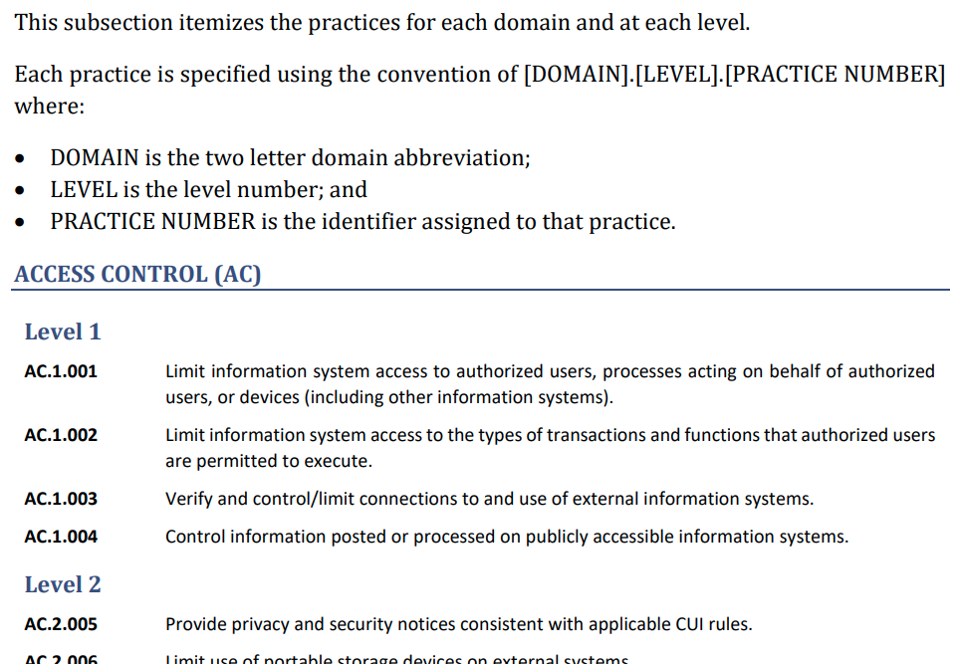
LIST OF PRACTICES

Slide 17
Path to CMMC-AB Certification
Understand CMMC requirements
Identify your scope. (Enterprise, Organization or Program Enclave)
Identify the desired Maturity Level
Optional. Pre-assess using an RPO or C3PAU
Close any identified gaps
Find a C3PAO on the CMMC-AB Marketplace
Conduct the Assessment with C3PAO’s certified assessment team
Allowance up to 90 days to resolve findings (if any)
CMMC-AB reviews submitted assessment
Upon approval, 3-year Certification issues!

Slide 18
QUESTIONS ?

Slide 19
rodney@mcleodis.com
https://www.mcleodis.com

Slide 20
REFERENCES AND LINKS
DOD CMMC Site - https://www.acq.osd.mil/cmmc/
SPRS References - https://www.sprs.csd.disa.mil/reference.htm
CMMC-AB Website - https://www.cmmcab.org/

